Slide 1
Midiendo el Grado de
Participación de los Usuarios de Twitter
en Temas Políticos
CASO DE ESTUDIO

Slide 2

Data Mining y Big Data en la práctica
Ciudadanía Digital en las Redes Sociales
Modelamiento de las tendencias políticas de los usuarios de Twitter
Mal uso de hashtags relacionados a temas políticos
Mujeres en la política: Argentina, elecciones 2017
Notes:
https://www.ncronline.org/blogs/just-catholic/globalization-technocratic-paradigm

Slide 3


RESEARCH QUESTIONS
Aim: Measuring the “degree of interest in politics” (DoIP) of tweeters.
Política
Política
Política
Q1. ¿Es posible cuantificar el nivel de interés de un usuario en temas políticos?
Q2. El grado de interés de un usuario en la política está positivamente correlacionado con el de sus amigos?
¿Cuán interesados en la política están tus amigos?
Notes:
Twitter has been broadly considered in the literature because of its effect on recent socio-political changes in different countries and regions.
By identifying the level of interest in politics of a user we can provide them with meaningful recommendations such as political actors to follow, tweets talking about politics, and political-oriented lists, among others.
Proposed approach: Degree of Interest in Politics “DoIP” of citizens in Twitter
The degree of citizens participation and political involvement varies
Difficulty to define citizen’s degree of political participation or interest
the extent of content published every second
the dynamic linkage among users and
the wide purpose-oriented nature of Twitter
Identifying the “DoIP” to provide meaningful recommendations:
political actors to follow
tweets talking about politics
political-oriented lists (and others)
Q3. Could Q1 and Q2 be used in the design stage of a ‘following back’ recommender system?

Slide 4
Introducción: Grado de Interés de un Usuario en la Política Degree of Interest in Politics of a user “DoIP”
Dificultad para definir su interés
La cantidad de contenido publicado cada segundo
Los enlaces dinámicos entre usuarios
Amplios propósitos o naturaleza de Twitter
Identificar el “DoIP” para ofrecer recomendaciones relevantes :
Figuras políticas a <SEGUIR>
Tweets que hablan acerca de temas políticos
Listas de Twitter orientadas a la política
Notes:
Varies from person to person
Reasons of difficulty to define DoIP
Advantages of defining DoIP for a user

Slide 5
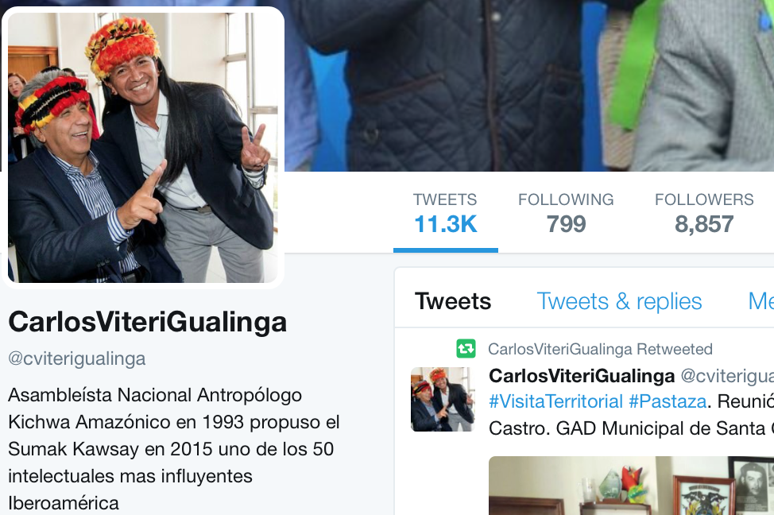
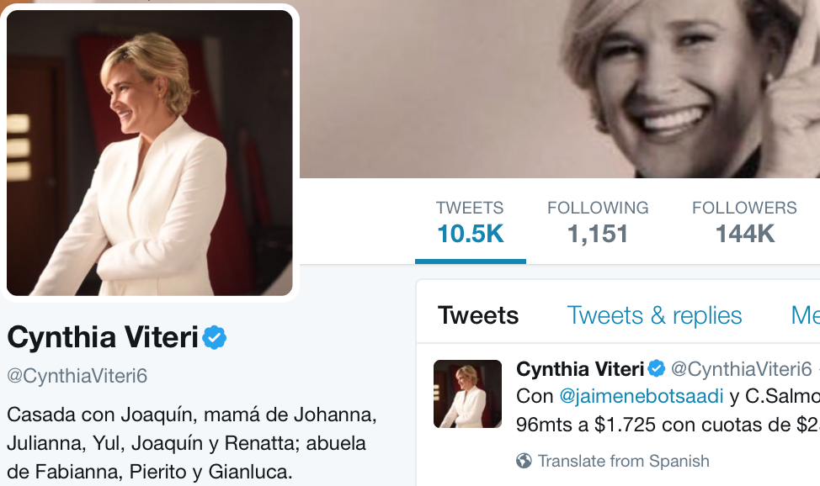
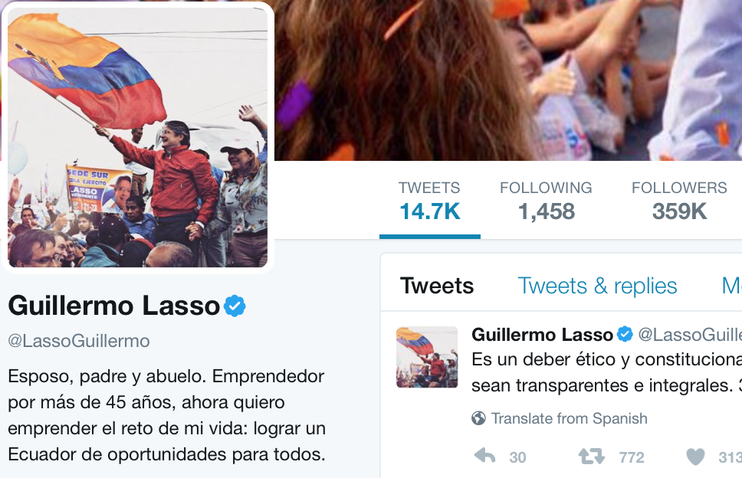
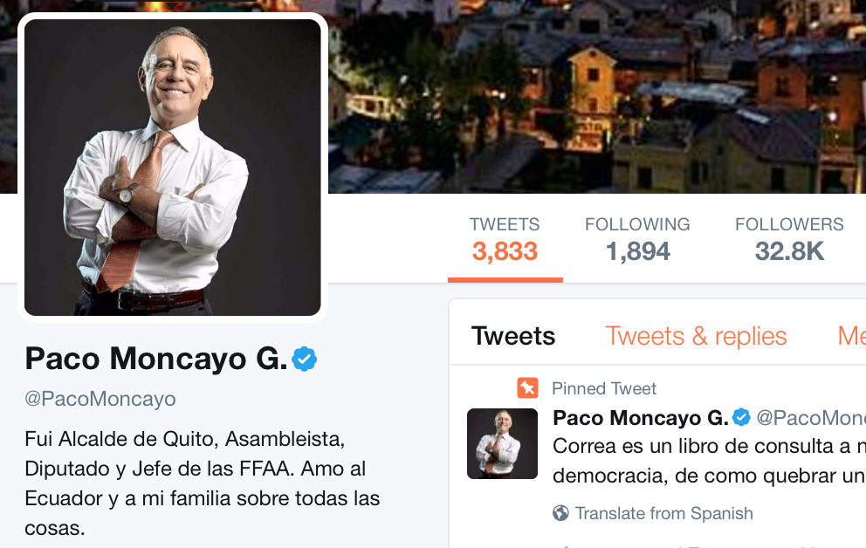
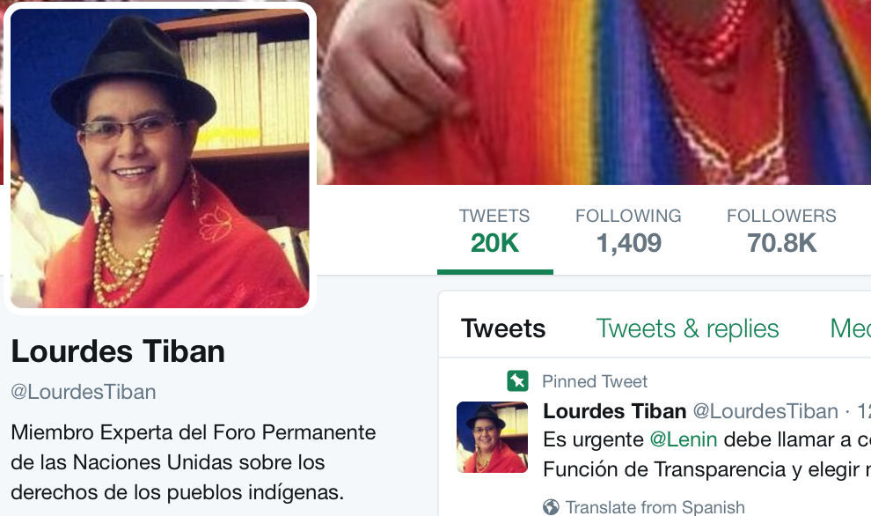
Motivación
Who is suitable to be followed-back when you are a Tweeter interested in politics

Slide 6
Diseñando un Sistema de Recomendación: following back recommender system
1. Method to detect Twitter users' DoIP
2. Correlation between users' DoIP and their Twitter friends' DoIP
3. Experiments on real data in the context of politics in Ecuador
“friend” denotes bidirectional or mutual relationship between two Twitter users
Notes:
Method
Correlation of the users' DoIP facing their Twitter friends' DoIP which can be further applied to design “following back” recommendations
Experiments on real data in the context of politics in Ecuador show the effectiveness of our approach in identifying the DoIP of Twitter citizens and the positive association of it with their friends'.

Slide 7
MÉTODO
Método para detectar el DoIP de los usuarios de Twitter
Word embeddings para representar los tweets de los ciudadanos. Calidad de resultados al aplicar word2vec vs Glove.
Calcular el DoIP de los usuarios cuantificando el número de tweets que hablan de política
Para el diseño de las recomendaciones: correlación del DoIP de los usuarios con
el DoIP de sus <amigos>
Degree of Interest in Politics of a user “DoIP”
Similitud de un tweet respecto al ‘political vector space’
Notes:
Method
Correlation of the users' DoIP facing their Twitter friends' DoIP which can be further applied to design “following back” recommendations
Experiments on real data in the context of politics in Ecuador show the effectiveness of our approach in identifying the DoIP of Twitter citizens and the positive association of it with their friends'.
“friend” denotes bidirectional or mutual relationship between two Twitter users

Slide 8
DoIP de los usuarios
Text Modeling
Calculation of DoIP of Twitter Users.
Following Back / Lists Recommendation
Text Preprocessing
Models Training and Performance Comparison
Clustering and Centroids Extraction
Similarity of a Tweet and Cluster Centroids
User’s DoIP Extraction
Notes:
1. Text Modeling. A corpus of tweets is employed to build a model with the word2vec training algorithms. The model generates a vector representation of the corpus' words.
2. Calculation of DoIP of Twitter Users. Tweets of citizens are converted into vectors by using the model so that we can apply the proposed method and measure in which extent they are interested in politics.
3. The association of users' DoIP to the DoIP of their Twitter friends can be further used to build a following back recommender system. Depending on the amount of tweets in the context of politics published by the user, we can define to what extent he/she is interested in this topic. This users characterization may be useful when modeling their political profile and then determining if a recent follower is significant to be followed back.

Slide 9
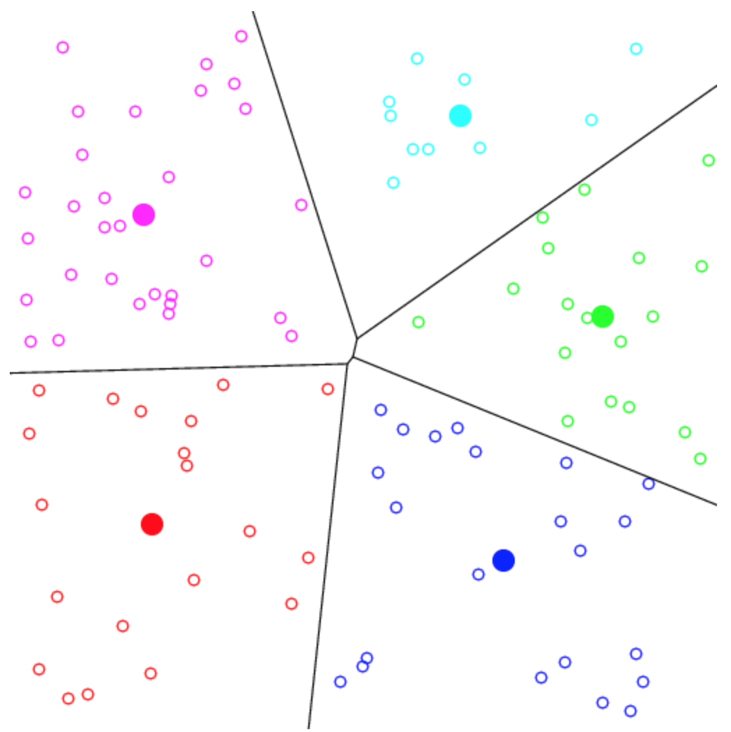
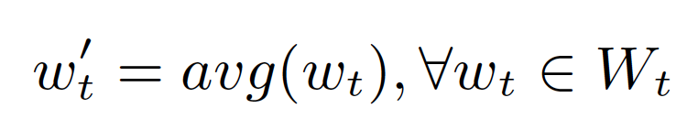
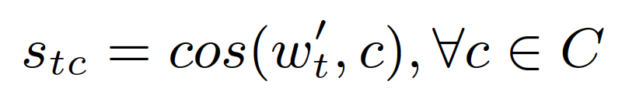
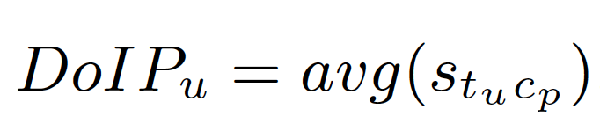
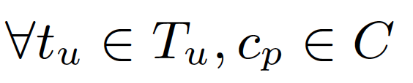

Ejemplo
t = ‘Soplan vientos de cambio para el país...’
Centroid_1
¿Cuál es la similitud de t y$c_{p}$?
Centroid_2: $c_{p}$
1.
Centroid_3
2.
Centroid_4
3.
Centroid_5

Slide 10
Datasets
Training Corpus
The corpus used to train the model contains 281,338 tweets.
Sample of Politicians
31 Politicians and their tweets were extracted.
This dataset was used to test the accuracy of our approach, defining the number of dimensions of the model (300) as well as the number of clusters (5).
Sample of Ecuadorian Twitter Users
To calculate the DoIP of digital citizens, 763 Ecuadorian users were selected.
To demonstrate the positive association of the user's DoIP and his/her
friend's DoIP, we extracted a list of 22,523 friends (bidirectional following)
of the 763 digital citizens.
Twitter Users' Friends
Twitter Users' Lists
We collected the tweets of 981 lists where the users were subscribed and the tweets of 1988 lists where the users participate as members.

Slide 11
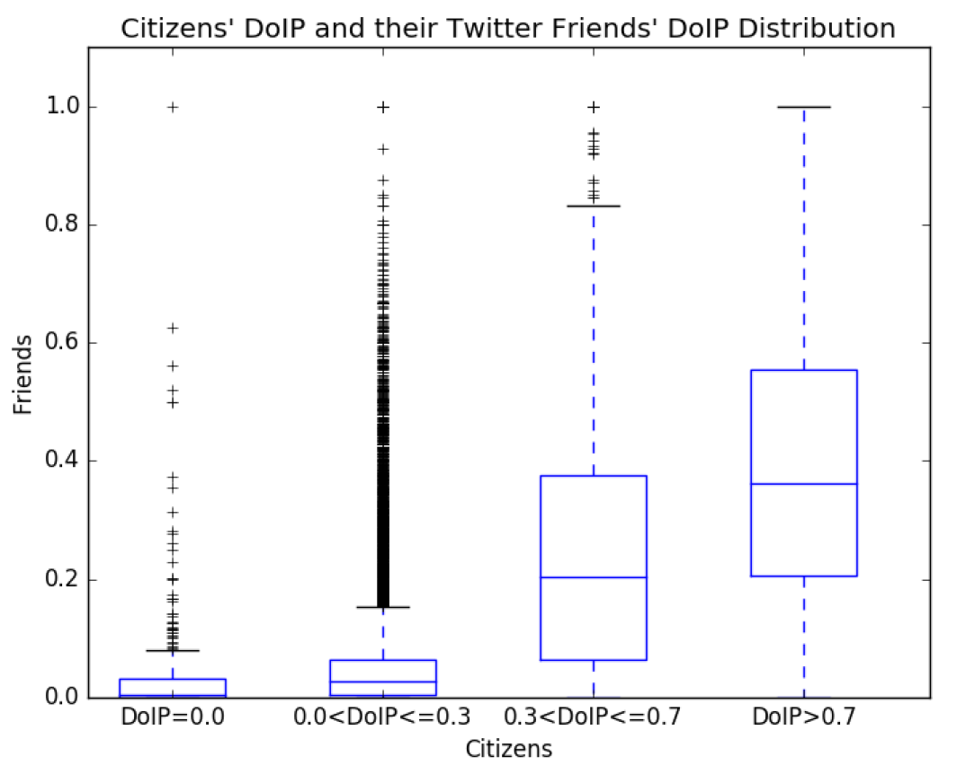
Results: DoIP of a Twitter User vs their Friends'
Positive association of users’ topics of preference with their friends’ interests
Which followers are suitable to be followed back?
Notes:
It is well known that friends share some similar interests. This assumption was verified by finding the correlation between digital citizens' DoIP and their friends’.

Slide 12
Calcular el DoIP de usuarios de Twitter
https://github.com/lore10/GEITEC_curso

